Slide 1
VECTO Trailer Tool
User Manual Version 0.9.0
DG CLIMA

Slide 2
About this release version
This release is a feature complete version of the VECTO Trailer Tool for the first implementation of the Regulation as regards the performance of heavy-duty trailers with regard to their influence on the CO₂ emissions, fuel consumption, energy consumption and zero emission range of motor vehicles and amending Implementing Regulation (EU) 2020/683
This is not yet an official version, as the standard values for ΔCdxA reduction rates for aero features on DB and DC trailers are still not fixed.
In this respect, placeholder values are implemented in the present version (details see slides 38 and 39).
Any official calculations carried out after the regulation has come into force must be carried out with subsequent official releases!

Slide 3
Content
References to information in Technical Annexes of the Trailer Regulation
VECTO Trailer Tool
  Platform requirements and installation options
  Software package
  JobFiles GUI
  Options GUI
  Background worker
  How to create or edit trailer job
  Result files
  What is the “Efficiency ratio”?
  What is the “Reference ratio”?
  Hashing
  Plausibility checks
  Options for automation
Handling of aerodynamic devices
  Generation of input XML for a certified aero device
  Standard aerodynamic devices: Reduction values and allowed configurations
Handling of liftable and steered axles
  Bonus factors
  Rules for multiple liftable and/or steered axles
Overview content of VECTO Trailer Tool Masterexcel

Slide 4
References to information in Technical Annexes of the Trailer Regulation
Annex Number | Title | Further Explanation
Annex I | Classification of vehicles in vehicle groups | Required definitions and classification system for trailers covered by the Regulation
Annex II | Requirements and processes for the operation of the simulation tool | Requirements for the process to be able to determine the official values within the framework of trailer regulation by means of the VECTO Trailer Tool
Annex III | Input information about the characteristic of the vehicle | Definitions and precise description of the input parameters into the tool and how to determine them
Annex IV | Template of the Manufacturer‘s Records file and of the Customer Information file | Definition of content and structure of the Manufacturer‘s Records file (MRF) and the Customer Information file (CIF)
Annex V | Vehicle‘s air drag data | Defines the procedures how the features of aerodynamic devices shall be determined, either via virtual testing using CFD or by applying standard reduction rates for aerodyanmic devices fulfilling certain minimum properties

Slide 5
Platform requirements
Hardware Requirements
Microsoft Windows PC running Microsoft Windows 7 or later
Software Requirements
Microsoft .NET Framework 4.8
Software Requirements to use the pdf function of the tool
Microsoft Visual C++ Runtime must be installed. If this is not the case for your computer, it can be downloaded free of charge from the following links:
  32 bit: https://aka.ms/vs/17/release/vc_redist.x86.exe
  64 bit: https://aka.ms/vs/17/release/vc_redist.x64.exe

Slide 6
Installation Options
VECTO Trailer Tool is distributed as a portable application. This means you can simply unzip the archive and directly execute it. This, however, requires write and execute permission for the VECTO Trailer Tool application directory.
In case you do not have execute permissions, please ask your system administrator to install VECTO Trailer Tool into an appropriate directory (e.g. under C:\Program Files). Installing VECTO Trailer Tool requires the following two steps:
Copy the VECTO Trailer Tool directory and all its files and subdirectories to the appropriate location where the user has execute permissions
Edit the file install.ini and remove the comment character (#) in the line containing ExecutionMode = install
If the ExecutionMode is set to install (this is also possible when running VECTO Trailer Tool from an arbitrary directory), VECTO Trailer Tool does not write its configuration files and log files to the application directory but to the directories %APPDATA% and %LOCALAPPDATA% (usually C: \User\<username>\AppData\Roaming and C: \User\<username>\AppData\Local).
Important: If the ExecutionMode is set to install it is necessary that you copy the generic VECTO Trailer Tool models distributed with VECTO Trailer Tool to a location where you have write permissions as VECTO Trailer Tool writes the results to the same directory as the job files

Slide 7

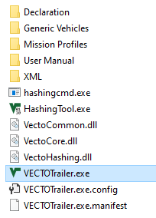
VECTO Trailer Tool – Software package
Content of VECTO Trailer Tool package as downloaded from JRC server
can be copied to any place on a PC/server*
Example files for trailers, tyres, certified aerodynamic devices and XML files of the generic towing vehicles
Example XML files and XSD files
VECTO Hashing Tool
VECTO Trailer Tool Executable, double-click to start
* Snapshot shows only a reduced set of data included in the downloadable package

Slide 8
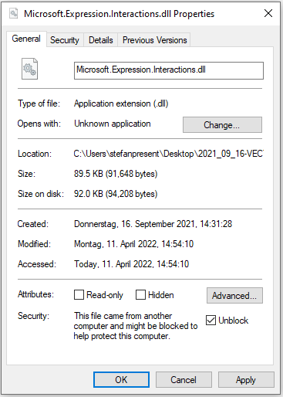
VECTO Trailer Tool – What to do if tool doesn’t start
Such a behaviour has been observed in cases where the VECTO Trailer Tool software package was unpacked with the Windows Explorer and marked the executables and dlls as unsafe (because loaded from the internet).
How to fix this?
Option 1:
Check all exe and dlls and mark them as “safe” → explorer
→ right click properties and then in the lower area tick the box that
says “Unblock” (see Snapshot to the right)
Option 2:
Unpack VECTO Trailer Tool with another software (“7zip” for example)

Slide 9
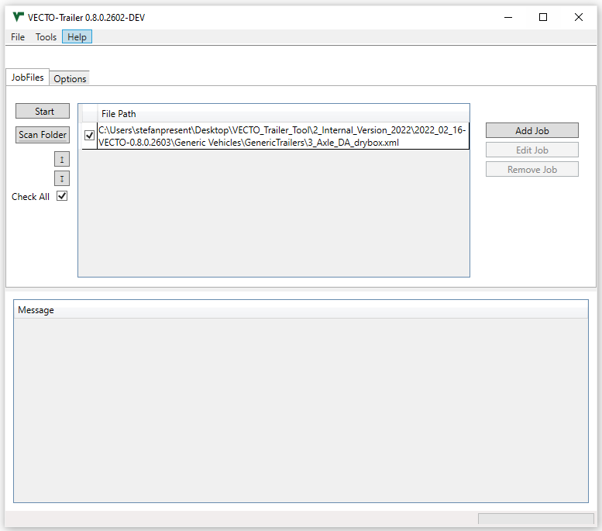
VECTO Trailer Tool – JobFiles GUI
Toolbar with common controls like
add new Job
search for Job files
open User Manual
etc.
Buttons to handle Job files
Add new Jobs
Edit existing Jobs from Job window
Delete Jobs from Job window
Switch between “Job Files” and “Options” tab
Start button to simulate active Jobs
Job window that shows all loaded Job files
Button to activate/stop background worker
Message window showing the calculation status

Slide 10
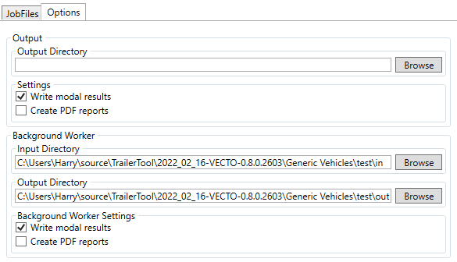
VECTO Trailer Tool – Options GUI
At first program start it is recommended to define the default output directory and check the settings for writing modal results and creating formatted pdf reports
Settings only affect the handling of input data or results, but do not influence the official results.
This input can be used to write all simulation result files to a certain directory. This can either be an absolute or a relative path
If selected, the tool writes modal results (.vmod files) for every calculation run. A Summary file (.vsum) is always created
If selected, the tool creates a formatted pdf report for both the CIF and MRF for every simulated job
Input/Output directories for the Background worker as well as options to write modal outputs and pdf reports of the simulation runs

Slide 11
VECTO Trailer Tool - Background worker
Enables a simple automation of simulation runs
The background worker periodically (i.e. every 4 seconds) searches a directory specified by the user for new input XMLs (Input Directory)
If a new file is available, a calculation is automatically started in the background
After completion, the result files are stored in another directory to be specified by the user (Output Directory)*
Important boundary conditions / information on using the Background worker
  Input and Output Directory must be different folders
  In case an erroneous file is read from the Input directory, the tool will display an error message but still simulate the remaining valid Job files
*The background worker has to be initiated for a certain input/output directory by pressing the
„Scan Folder“ button under „JobFiles“

Slide 12
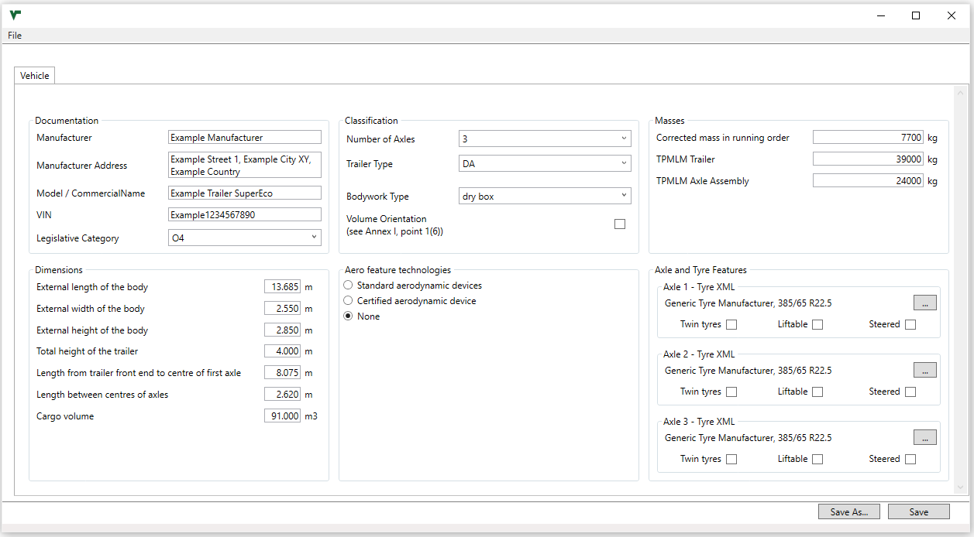
VECTO Trailer Tool – Create or edit trailer job (1/6)
Open window via
  “Edit Job” or
  Right click on Job window → “Create Trailer Job”
Define main trailer specifications
Define Aero feature technologies
Define Axle and Tyre features

Slide 13
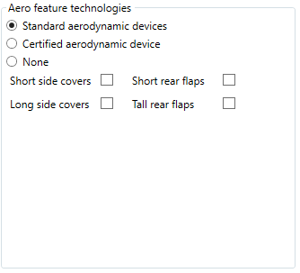
VECTO Trailer Tool – Create or edit trailer job (2/6)
Define Aero feature technologies
Select if standard values for reduction rates from aero devices are to be applied
Checkbox to declare applicable standard aerodynamic device(s)
Note that not all combinations are valid → see also:
Masterexcel sheet „Combination Add-ons“
Trailer_combination_addon.csv in the Declaration folder
Task 2 report
Standard values as automatically allocated by the VECTO Trailer Tool are documented in:
Masterexcel sheet „Combination Add-ons“ or „Specific Trailer“ column Y to BH
Specific_trailer.csv in the Declaration folder
Task 2 report

Slide 14
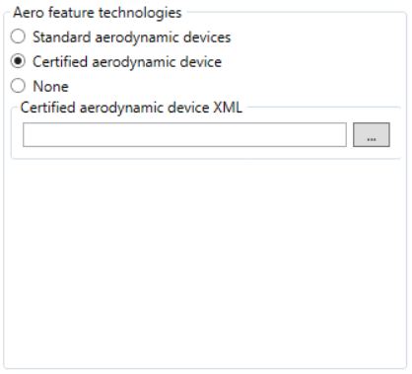
VECTO Trailer Tool – Create or edit trailer job (3/6)
Define Aero feature technologies
Select if certified reduction rates from aerodynamic devices are to be applied
Brows button to browse for the XML file of the certified aerodynamic device

Slide 15
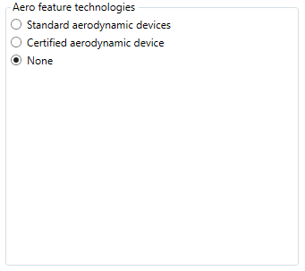
VECTO Trailer Tool – Create or edit trailer job (4/6)
Define Aero feature technologies
Select if the trailer is equipped with no aerodynamic device(s)

Slide 16
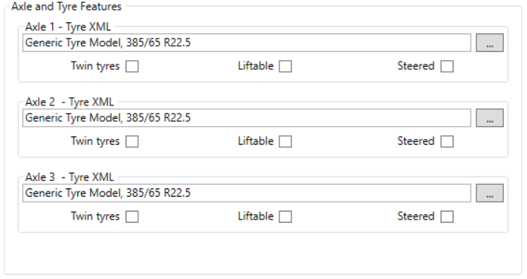
VECTO Trailer Tool – Create or edit trailer job (5/6)
Define Axle and Tyre features
Checkbox to declare applicable tyre/axle features
Effects as automatically considered by the VECTO Trailer Tool for liftable/steered axles are documented in:
Masterexcel
  sheet „Specific Trailer“ column E to P
Specific_trailer.csv in the Declaration folder,
Task 2 report
Browse button to search for tyre XMLs

Slide 17
VECTO Trailer Tool – Create or edit trailer job (6/6)
Save Job file
Press “Start” in Job file editor to start simulation of active Jobs

Slide 18
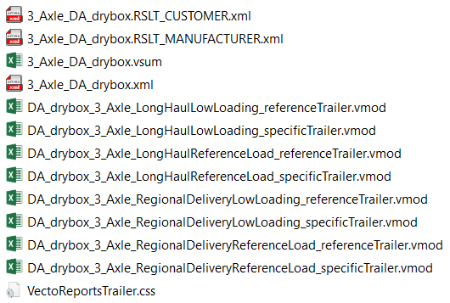
VECTO Trailer Tool – Result files (1/2)
Outputs created by the VECTO Trailer Tool including the corresponding Job file*
CIF/ Customer Information File
MRF/ Manufacturer’s Records File
vsum File
Job-File
vmod File per mission and payload combination for the reference and specific trailer
* Snapshot doesn't show all .vmod files calculated for this particular trailer configuration as well as the optionally created
pfd-file

Slide 19
VECTO Trailer Tool – Result files (2/2)
Result file | Description
Manufacturer‘s Records File (MRF) | Output for regulatory purpose in XML format a file produced by the simulation tool which contains manufacturer related information, a documentation of the input data and input information to the simulation tool, and the performance of the vehicle with regard to its influence on the CO2 emissions and fuel consumption of motor vehicles, and which takes the form of the template laid down in Annex IV, Part I
Customer Information file (CIF) | Output for regulatory purpose in XML format a file produced by the simulation tool which contains a set of vehicle related information and the performance of the vehicle with regard to its influence on CO2 emissions, fuel consumption, of motor vehicles, and which takes the form of the template laid down in Annex IV, Part II
Pdf-output | Formatted printable output of the customer information file
vsum-file* | Output for engineering purposes in csv-format. Single line of results per each simulated combination of trailer, mission profile and payload with aggregate and or average values
vmod-file* | Output for engineering purposes in csv-format. Single file per each simulated combination of trailer, mission profile and payload with time-resolved simulation results from the VECTO core.
* A documentation of the results contained in the vsum and vmod files can be found in the help file for the VECTO calculation core (help.html), which is also included in the VECTO Trailer Tool release.

Slide 20

What is the “Efficiency Ratio”? (1/2)
The Efficiency Ratio (ER) is a dimensionless characteristic value for the rating of a (semi-)trailer with regard to its influence on CO₂ emissions, fuel emissions and energy consumption of the towing vehicle.
$$Efficiency Ratio=\frac{{CO}_{2, spec\left(S\right)T}}{{CO}_{2, ref\left(S\right)T}}$$
Where:
CO_{2, spec(S)T} ... CO₂ emissions with the generic towing vehicle and the specific (semi-)trailer
CO_{2, ref(S)T} ... CO₂ emissions with the generic towing vehicle and a reference (semi-)trailer
Accordingly, an ER of 0.95 indicates that CO₂ emissions are 5% lower with the specific (semi-)trailer than with the reference trailer.
ERs are provided:
For CO₂ emissions in the units “grams per km”, “grams per ton-km” and “grams per m³-km”
For each relevant mission profile and payload combination and for the weighted-mix of mission profiles and payloads
Reference (semi-)trailers are defined for all vehicle groups currently covered by the Regulation and represent typical configurations (mass, dimensions, rolling resistance) as of approx. the year 2020. The specifications of these reference (semi-)trailers are documented in the VECTO Trailer Tool Masterexcel. However, their knowledge is not essential for the interpretation of the ERs.

Slide 21
What is the “Efficiency Ratio”? (2/2)
Further information for individual use of the results from the VECTO Trailer Tool:
Since fuel consumption and CO₂ emissions correlate linearly, the results as indicated by the ERs also apply to fuel consumption. For energy consumption of fully electric vehicles, at least similar trends apply.
If (semi-)trailers in different groups are to be compared with each other (e.g. a standard variant with a volume-oriented variant), this cannot be done using the ER, as the reference (semi-)trailers are different. Such a comparison can be made using the results for fuel consumption (lit./100km, g/km) or CO₂ emissions (g/km). For a direct comparison, it must be ensured that the assigned generic towing vehicles are also identical on the basis of Annex I.
Results for fuel consumption in the units lit./100km, g/km and CO₂ emissions in the unit g/km can be interpolated or extrapolated to other payload conditions in a specific mission profile in a very good approximation via the linear trend established by the results for the two fixed payloads as provided by the VECTO Trailer tool.

Slide 22

What is the “Reference Ratio”? (1/4)
Basics
The "reference ratio" is the ratio between two CO₂ emission values simulated with a generic towing vehicle, once coupled to the reference trailer as defined for each trailer vehicle group and once coupled to the standard trailer as defined for the towing vehicle group in Regulation (EU) 2017/2400.
The reference ratio is a numerical value that allows a vehicle operator to combine the results from the motor vehicle VECTO for the towing vehicle with the results from the VECTO Trailer Tool for the trailer to produce specific results for the combination of both. How this is done is explained on the following slides.
The reference ratio is a fixed numerical value per trailer vehicle group, mission profile and payload and completely independent of the inputs for a specific trailer.
The reference ratio is purely a "service" for a vehicle operator and has yet no application within the framework of a Regulation.
$$Reference Ratio=\frac{{CO}_{2, ref\left(S\right)T}}{{CO}_{2, stand\left(S\right)T}}$$
Where:
CO_{2, ref(S)T} ... CO₂ emissions with the generic towing vehicle and the reference (semi-)trailer
CO_{2, stand(S)T} ... CO₂ emissions with the generic towing vehicle and a standard (semi-)trailer

Slide 23
What is the “Reference Ratio”? (2/4)
Basics
Calculation of fuel consumption and CO₂ emissions for a specific vehicle combination for which VECTO results for both the towing vehicle and for the (semi-)trailer are available:
FC or CO₂ = FC or CO₂ · Reference Ratio · Efficiency Ratio
For the specific vehicle combination
Units: lit./100km; g/km
VECTO result for the specific towing vehicle
Units: lit./100km; g/km
VECTO Trailer Tool results for the specific (semi-)trailer
The following constraints need to be considered:
The towing vehicle must be of the same vehicle group (e.g. “9”) as the generic towing vehicle defined in Annex I for the (semi-)trailer.
The calculation must be carried out separately for each combination of mission profile and paylaod.
The calculation can only be performed for the units specified above. For the Efficiency Ratio the "kilometre-based" value is to be used.

Slide 24
What is the “Reference Ratio”? (3/4)
Application example
Vehicle configuration: Group 9 lorry with drawbar trailer
Results motor vehicle VECTO
Results VECTO Trailer Tool
Mission profile | Vehicle configuration as in VECTO for motor vehicles | Vehicle configuration as in VECTO Trailer Tool | Payload | FC (l/100km) towing vehicle | Reference ratio | Efficiency ratio | FC (l/100km) specific combination
Long haul | Specific group 9 lorry + T2 standard trailer (type DC) | Generic group 9 lorry + specific DB trailer | low | 26.8 | 0.929 | 0.973 | 24.2
 |  |  | rep. | 34.8 | 0.949 | 0.965 | 31.9
Regional delivery | Specific lorry as “rigid solo” | Generic group 9 lorry + specific DB trailer | low | 20.1 | 1.282 | 0.976 | 25.1
 |  |  | rep. | 23.5 | 1.368 | 0.972 | 31.2
Other mission profiles are not of relevance (urban delivery is not simulated for group 9 vehicles by motor vehicle VECTO, municipal cycle is not relevant for trailers)

Slide 25



What is the “Reference Ratio”? (4/4)
Background information: Formulas and validation
With this approach one does not get exactly the same result as if one would have the specifications of both the specific towing vehicle and the specific trailer available with a single VECTO simulation. The reason is that the "correction factor" (in green, calculated by the VECTO trailer tool via the reference and efficiency ratios) can only be determined based on the specifications of the generic towing vehicle. This results in principle-related deviations, which are also accepted in the factor method used for heavy buses in VECTO.
The calculation example shown on slide 25 was compared with results from a single VECTO simulation for validation purposes. The deviations were below 1%.
$$FC or {CO}_{2} = FC or {CO}_{2 } ∗ \text{Reference} \text{Ratio}∗\text{Efficiency} \text{Ratio}$$
For the specific vehicle combination
Units: lit./100km; g/km
VECTO result for the specific towing vehicle and standard (semi-)trailer
Units: lit./100km; g/km
VECTO Trailer Tool results for the specific (semi-)trailer
$$Reference Ratio$$
$$Efficiency Ratio$$
$FC or {CO}_{2} = FC or {CO}_{2 }∗ \frac{{CO}_{2,ref\left(S\right)T}}{{CO}_{2,stand\left(S\right)T}}∗$ $\frac{{CO}_{2,spec\left(S\right)T}}{{CO}_{2,ref\left(S\right)T}}$
$FC or {CO}_{2} = FC or {CO}_{2 }∗$ $\frac{{CO}_{2,spec\left(S\right)T}}{{CO}_{2,stand\left(S\right)T}}$
✓
For the specific vehicle combination
Units: lit./100km; g/km
VECTO result for the specific towing vehicle and standard (semi-)trailer
Units: lit./100km; g/km
Correction factor, how much FC / CO2 of the specific towing vehicle changes as the specific trailer and not the standard trailer is coupled

Slide 26
Hashing (1/2)
The following hashing functions are integrated into the automated programme sequence of the VECTO Trailer Tool:
The trailer input XML is hashed before the simulation and the hash is written to the MRF.
The hash of the trailer MRF is calculated and written to the CIF.
The hash of the trailer CIF is calculated and written to the CIF.
→ This means that in the official application of the tool for calculating the "Performance of new vehicles with regard to their influence on CO₂ emissions and fuel consumption“ all steps with regard to hashing are automated. The separate VECTO Hashing Tool is not used.

Slide 27
Hashing (2/2)
The VECTO Hashing Tool shall be used in the context of certified input XMLs:
Creation of the component hash
Verification of the component hash
This process is demonstrated on subsequent slides on the example of certified aerodynamic device input XML.
For tyre input XMLs, the entire process is completely identical to Regulation (EU) 2017/2400.

Slide 28
Plausibility checks for input data
IF | THEN
Number of Axles = 1 | No Type DB allowed
Trailer Type = DB + Number of Axles = 2 | Axle 1: steered and not liftable Axle 2: not liftable and not steered
Trailer Type = DB + Number of Axles = 3 | Axle 1: steered and not liftable Axle 2: not steered Maximum 1 axle is liftable
Trailer Type = DC + Number of Axles = 1 | Legislative Category = O3
Trailer Type = DA + Number of Axles = 1
Trailer Type = DC + Number of Axles = 1 | Axle 1: not liftable and not steered
Trailer Type = DC + Number of Axles = 2 | Axle 1: not steered
Trailer Type = DC + Number of Axles = 3 | Axle 1: not steered Axle 2: not liftable and not steered
Trailer Type = DA + Number of Axles = 1 | Axle 1: not liftable
Trailer Type = DA + Number of Axles = 2 | Axle 1: not steered
Side covers short | No Side covers long
Side covers long | No Side covers short
Trailer Type = DB | No Side covers long
Trailer Type = DC | No Side covers long
Rear flaps short | No Rear flaps long
Rear flaps long | No Rear flaps short
Trailer Type = DC | TPMLM Axle Assembly ≤ TPMLM Trailer
Trailer Type = DA | TPMLM Axle Assembly < TPMLM Trailer
Parameter | Requirements
VIN | 17 characters
Mass in running order, TPMLM Trailer and TPMLM Axle Assembly | >1.000kg
External width of the body | 1000 mm< x ≤ 2.600mm
Total Height of the Trailer | 1000 mm< x ≤ 4.000mm
External height of the body | < Total height of the Trailer
External length of the body | < Max. length per type: Body DA ≤ 14.000mm Body DC ≤ 12.000mm Body DB ≤ 12.000mm
Important note:
The listed checks can only catch gross implausibilities in the inputs to the tool. More subtle errors, e.g. typos in the numbers, in the input will remain undetected. In any case, within the scope of the official application of the tool, the user of the tool must be responsible for the correctness of the entries. Compliance with the corresponding quality standards is the subject of the process certification according to Annex II of the regulation.

Slide 29
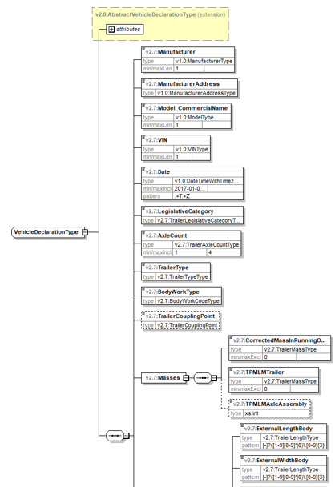
Options for automation
The process for generating official results of the VECTO Trailer Tool can also be fully automated.
Generation of input XMLs
  E.g. create it out of your product database system
  XML schema files are distributed with the tools
  (see snapshot)
  Running the simulation
  Use the “background worker” feature as shown in the live demonstration and described in the User Manual
  Use the command-line tool vectocmd.exe as distributed with the archive.
  → vectocmd.exe –q <XML-File>
  Calling VECTO from your own application is also possible.

Slide 30
Generation of input XML for a certified aero device (1/4)
The XML needs to be created by the supplier within a separate certification process
A template of the XML is located in the downloadable VECTO Trailer Tool package in the “Generic vehicles” folder
The XSD file is located in the downloadable VECTO Trailer Tool package in the “XML” folder

Slide 31
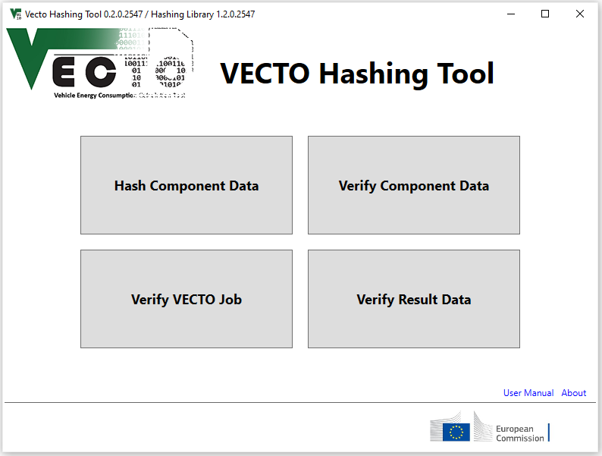
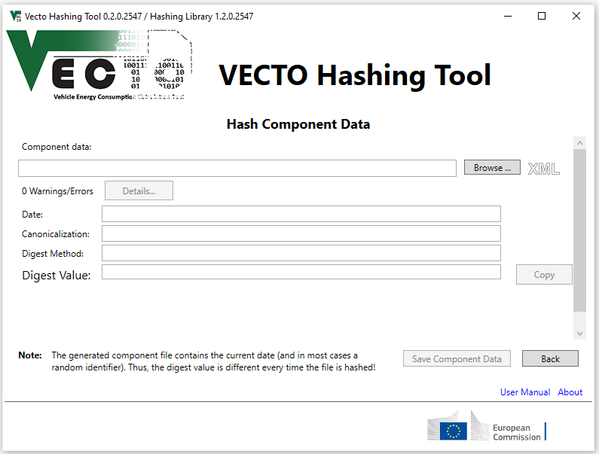
Generation of input XML for a certified aero device (2/4)
At the start screen click „Hash Component Data“
  then click the browse button to search for a non hashed XML → XML will be hashed automatically once loaded to the hashing tool

Slide 32
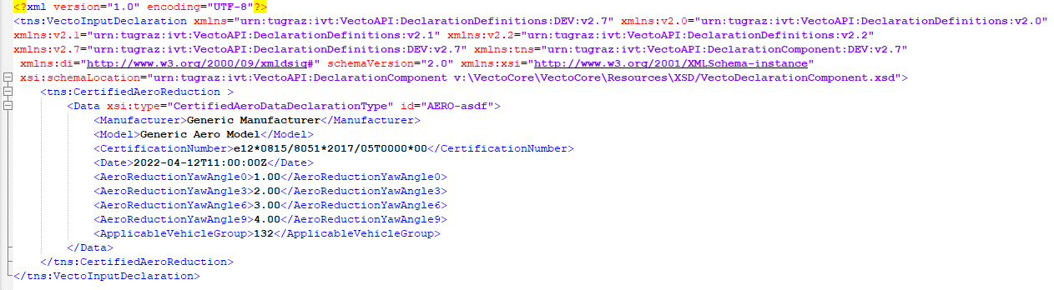
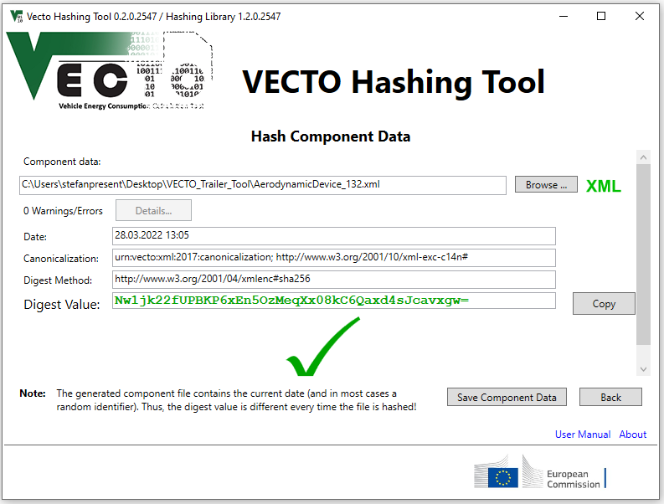
Generation of input XML for a certified aero device (3/4)
Hashing example
After succesfull hashing of the component XML click „Save Component Data“

Slide 33
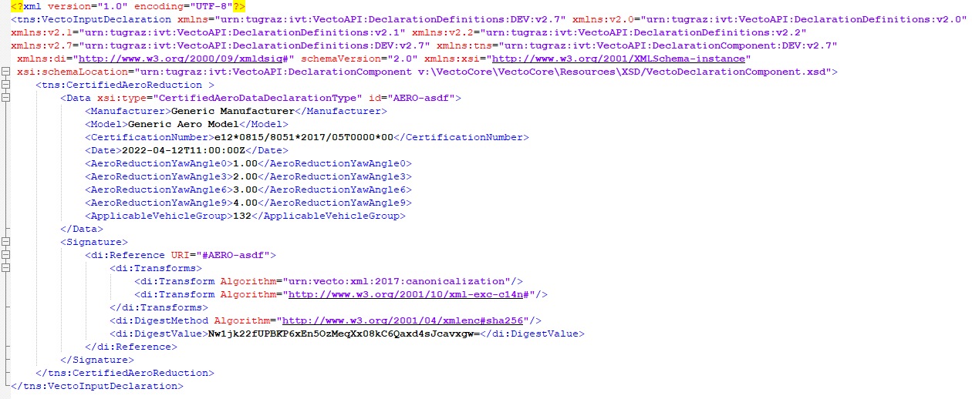
Generation of input XML for a certified aero device (4/4)
Hashing example
Hashed component File

Slide 34
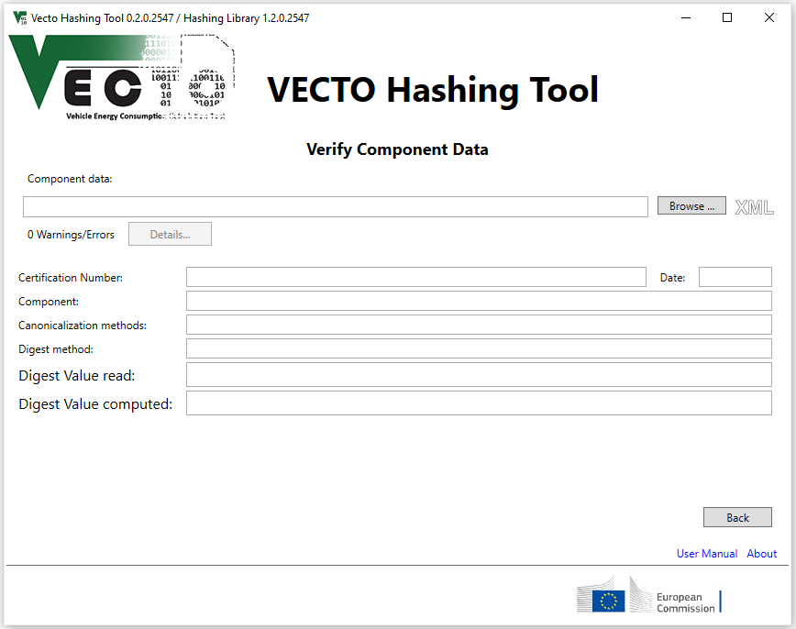
Verification of component hash for a certified aero device (1/3)
At the start screen click „Verify Component Data“
  then click the browse button to search for a hashed XML → Digest values will only match if nothing was changed after hashing

Slide 35
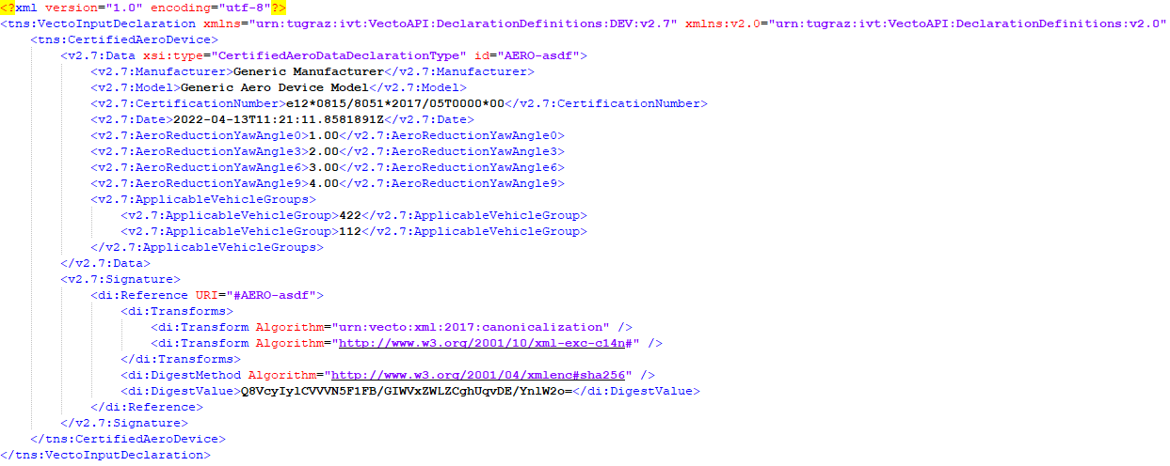
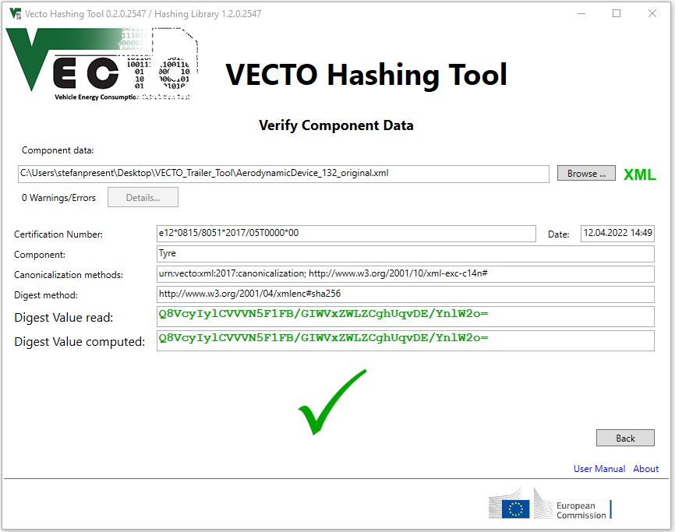
Verification of component hash for a certified aero device (2/3)
Example verification of an unchanged XML

Slide 36

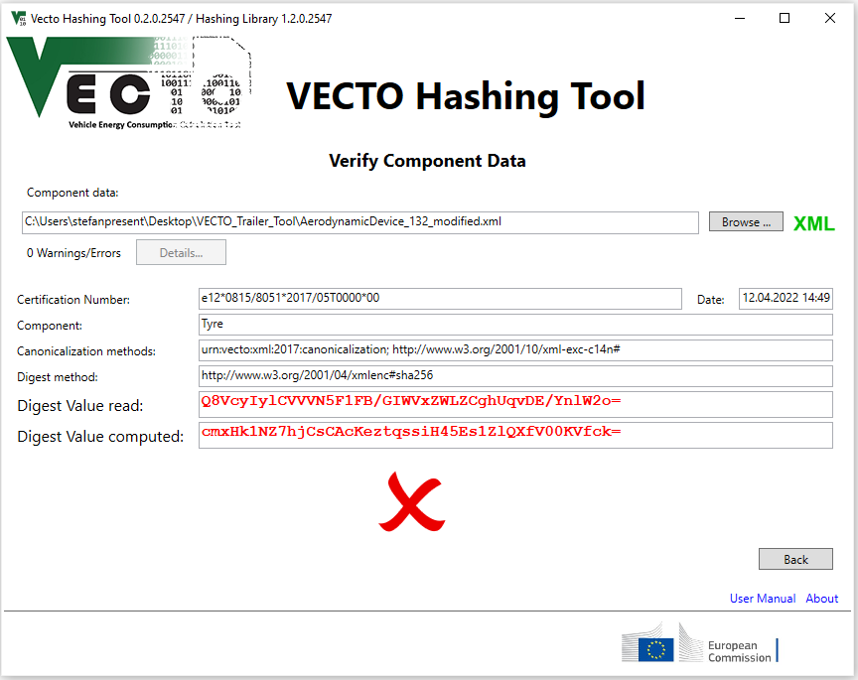
Verification of component hash for a certified aero device (3/3)
Example verification of a modified XML

Slide 37
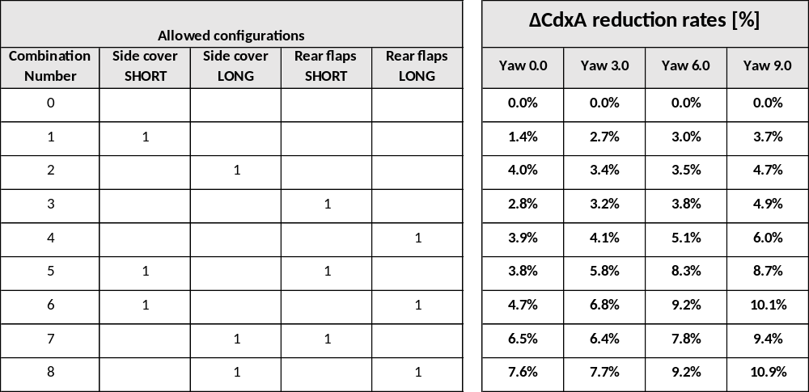
Standard aerodynamic devices – for DA trailers

Slide 38
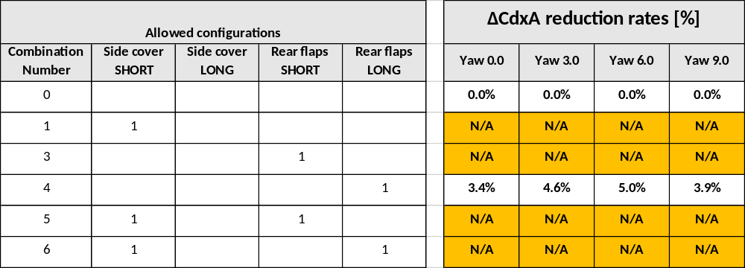
Standard aerodynamic devices – for DB trailers
Missing values to be completed via CFD in second half of 2022
The tool version as released in June 2022 applies placeholder dummy values instead.
THIS IS INTENDED, PLEASE WAIT FOR THE FINAL RELEASE AFTER THE WORK ABOVE HAS BEEN COMPLETED.

Slide 39
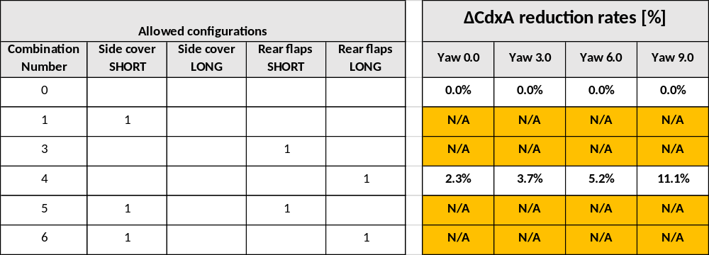
Standard aerodynamic devices – for DC trailers
Missing values to be completed via CFD in second half of 2022
The tool version as released in June 2022 applies placeholder dummy values instead.
THIS IS INTENDED, PLEASE WAIT FOR THE FINAL RELEASE AFTER THE WORK ABOVE HAS BEEN COMPLETED.

Slide 40
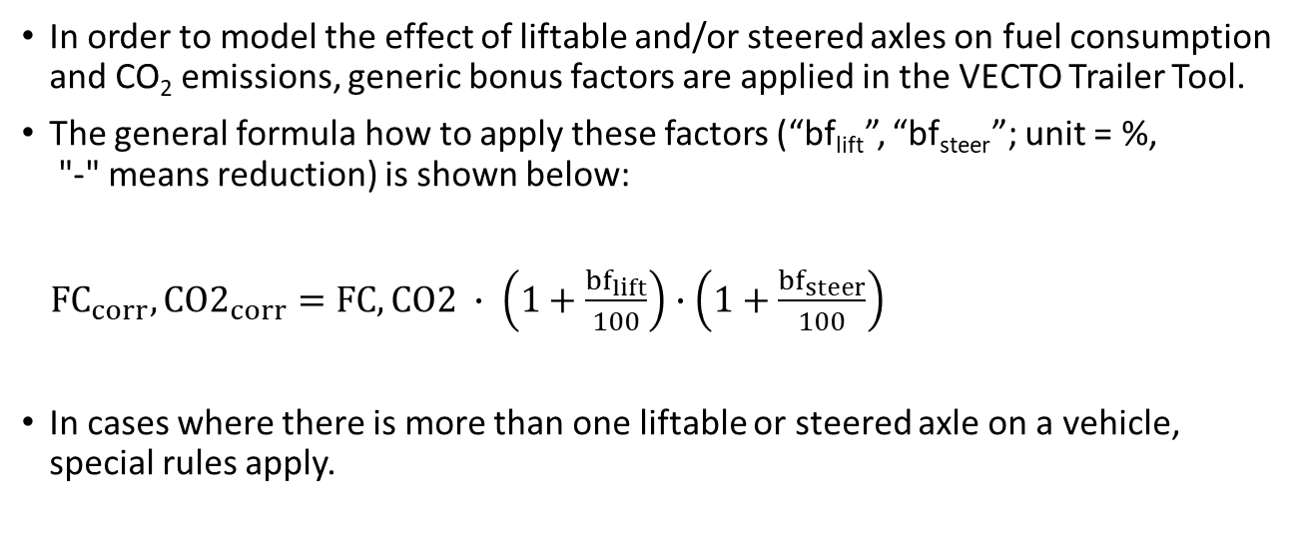
Bonus factors for liftable and steered axles - Overview
In order to model the effect of liftable and/or steered axles on fuel consumption and CO₂ emissions, generic bonus factors are applied in the VECTO Trailer Tool.
The general formula how to apply these factors (“bf_{lift}”, “bf_{steer}”; unit = %,
"-" means reduction) is shown below:
${FC}_{corr}, {CO2}_{corr}=FC, CO2 ∙ \left(1+\frac{{bf}_{lift}}{100}\right)$ $∙\left(1+\frac{{bf}_{steer}}{100}\right)$
In cases where there is more than one liftable or steered axle on a vehicle, special rules apply.

Slide 41
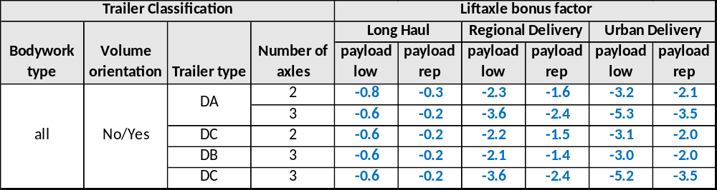
Bonus factors for liftable axles

Slide 42
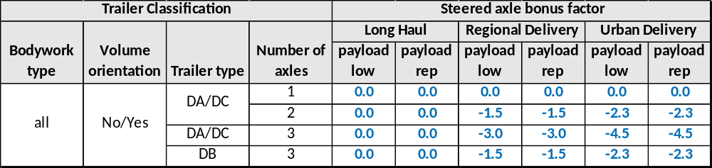
Bonus factors for steered axles

Slide 43

Bonus factors for liftable and steered axles –
Special cases
Special case #1: 1 liftable and 1 steered on different axles
${FC}_{corr}, {CO2}_{corr}=FC, CO2 ∙ \left(1+\frac{{bf}_{lift}}{100}\right)$ $∙\left(1+0.5∙\frac{{bf}_{steer}}{100}\right)$
Special case #2: 1 liftable and 1 steered on the same axle
$${FC}_{corr}, {CO2}_{corr}=FC, CO2 ∙ \left(1+\frac{max⁡({bf}_{lift},{bf}_{steer})}{100}\right)$$
The generally valid formulas implemented in the code are documented here. For some cycles, some bonus factors are 0.

Slide 44
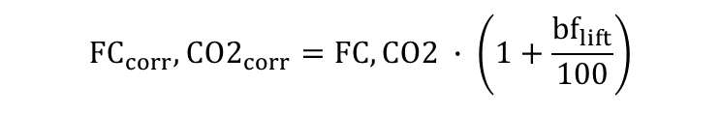
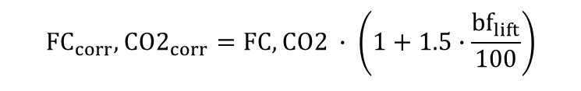
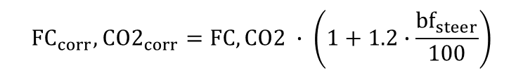
Bonus factors for liftable and steered axles –
Special cases
Special case #3: 2 liftable axles
$${FC}_{corr}, {CO2}_{corr}=FC, CO2 ∙ \left(1+1.5∙\frac{{bf}_{lift}}{100}\right)$$
Payload “low”:
$${FC}_{corr}, {CO2}_{corr}=FC, CO2 ∙ \left(1+\frac{{bf}_{lift}}{100}\right)$$
Payload “rep:”:
Special case #4: 2 steered axles
$${FC}_{corr}, {CO2}_{corr}=FC, CO2 ∙ \left(1+1.2∙\frac{{bf}_{steer}}{100}\right)$$
Special case #5: In case more than 2 features are present on the vehicle (could theoretically only be the case for a 3-axle trailer and comprising at least a single steered axle), the rules for special case #1 are applied.
The generally valid formulas implemented in the code are documented here. For some cycles, some bonus factors are 0.

Slide 45
Overview content of Masterexcel (1/4)
The VECTO Trailer Tool Masterexcel is an integral part of the tool documentation and fulfils the following functions:
Documentation of the classification matrix used internally in the tool, which is more detailed than the classification according to Annex I.
Documentation of all generic data stored in the tool, e.g.
  mission profile and payload allocation
  specifications of reference trailers
  standard values for reduction rates of aerodynamic devices
  bonus factors for liftable and steered axles
Interactive documentation of the formulas for calculating the air drag for the various combinations of generic towing vehicles and trailers
The content of the individual sheets is described in overview on the next slides.
In the context of a normal application of the tool, it is not necessary to engage with the Masterexcel.

Slide 46
Overview content of Masterexcel (2/4)
Excel sheet | Description
Classification | General information stored in the tool for each trailer configuration Vehicle group acc. to Annex 1 Information on the allocated generic towing vehicle Mission allocation + weighting for aggregated results Payload and axle weight shares per mission
Generic CAD vehicle | Main dimensions and air drag values of the generic CAD models used as a starting point to calculate the air drag of trailers with different dimensions (could be the reference- or the specific trailer)
Reference Trailer | Information on the reference trailers for each trailer configuration Curb mass and cargo volume Tyre specifications Main external dimensions to calculate the air drag Indication on which aero corrections are applied to which trailer configuration „1“ means aero correction is applied „0“ means aero correction is not applied

Slide 47
Overview content of Masterexcel (3/4)
Excel sheet | Description
... | ...
Specific trailer | Information on technologies that may be present on a specific trailer Bonus factors for liftable and steered axles depending on trailer configuration, mission and payload These factors are to be understood as reduction factors on overall fuel consumption / CO₂ Indication on which aero corrections are applied to which trailer configuration „1“ means aero correction is applied „0" means aero correction is not applied The individual aero correction formulas can be viewed in the “Reference/Specific Trailer Aero" sheet and are documented in detail in Task 2 report section 2.4.5. Aero reduction values for standard aerodynamic devices acc. to sheet „Combination Add-ons DX*“
Standard Trailer | Information on the standard trailers also used in Regulation EU 2017/2400 to calculate the reference factors
*DX... Placeholder depending on trailer type
DA... Semi Trailer
DB... Drawbar Trailer
DC... Centre axle Trailer

Slide 48
Overview content of Masterexcel (4/4)
Excel sheet | Description
... | ...
Reference (Specific) Trailer Aero | Main dimensions and air drag values of the generic CAD models used as a starting point to calulate the air drag of trailers with different dimensions (Reference/Specific trailer) Step by step calculation process on how to apply the individual aero corrections to get the final air drag values for a reference/specific trailer In the columns AN to AX, the aero-relevant data can be entered for the individual trailer groups. The results for CdxA(0) as well as the polynomial coefficients of the polar can then be found in the columns DT and EB to ED.
Standard aero device DX* | Air drag reduction in % for the specific combination of standard aerodynamic devices (the reduction values can also be found in the sheet „Specific Trailer“
Efficiency Ratios - DA | Example on how the individual and weighted efficiency ratios are calculated based on a DA trailer
*DX... Placeholder depending on trailer type
DA... Semi Trailer
DB... Drawbar Trailer
DC... Centre axle Traielr

